Slide 1

aSk Ren Platform
Modernizing Vehicle Rentals
Submitted by:
Kushagra Chaudhary, Shubh Sahu, Alok Kumar

Slide 2


Executive Summary
•
aSk Ren is a comprehensive full-stack digital platform designed to modernize vehicle rental processes.
•
Replaces legacy manual record-keeping with an automated, secure, and scalable system using Django and MySQL.
•
Facilitates seamless, trustworthy interactions between car owners and renting customers.
•
A centralized administrative approval workflow significantly improves transparency and eliminates manual errors.

Slide 3


The Challenge & The Goal
Business Problem
Project Objectives
Traditional car rental services frequently depend on manual logs and physical verifications, leading to operational inefficiencies and data inconsistencies. Furthermore, the lack of a structured onboarding mechanism for car owners limits overall business growth and user trust.
Digitize the conventional vehicle rental ecosystem into a unified platform. Implement a secure, role-based access control (RBAC) system. Enable real-time tracking of vehicle availability to prevent over-bookings, and provide a comprehensive administrative dashboard for monitoring activities.

Slide 4

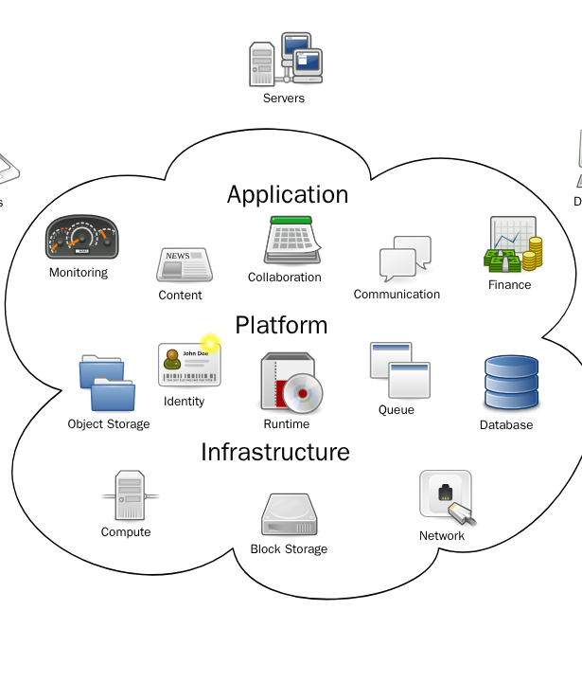
System Architecture
Modular Three-Tier Design
The aSk Ren platform utilizes a modular architecture ensuring clean separation of concerns: a Presentation Layer (Frontend), an Application Layer (Backend), and a Database Layer (Storage).
This architecture handles HTTP requests, routes them through Django views and business logic, and securely queries the MySQL database, facilitating highly independent scaling and robust performance.

Slide 5






Technology Stack
Frontend
Backend
Database
Tailwind CSS is utilized for a highly responsive, modern UI design, accompanied by standard HTML5 and vanilla JavaScript for interactive elements.
Django (Python) powers the core business logic, view orchestration, form validation, and the complete backend booking engine.
MySQL serves as the central storage solution, ensuring robust relational data storage, fast querying, and strict referential integrity.

Slide 6


Database & Data Flow
Relational Schema
Logical Data Flow
The database schema guarantees data integrity utilizing primary and foreign keys. The core entities include Users, Cars, Bookings, Reviews, and Payments, perfectly mapping the interactions between a renter and a vehicle owner.
The application follows a strict data flow hierarchy: Authentication (RBAC verification), Car Inventory Management (adding/updating), the Booking Engine (availability checks), Payment Processing (transactions), and overarching Admin Monitoring.

Slide 7
Core Platform Modules
Customer Dashboard: The central hub for renters to browse the fleet with robust filters, check real-time availability, manage their active/past bookings, and process secure payments.
Owner Dashboard: A comprehensive management suite for car owners to onboard new vehicles, manage availability calendars, review rental requests, and track their financial earnings.
Admin Dashboard: The centralized control panel allowing platform administrators to approve new listings, oversee user activity, suspend accounts, and generate deep analytical revenue reports.

Slide 8

Booking & Payment Flow
•
Users select precise pickup and drop-off dates, times, and locations via an intuitive interface.
•
The Django backend performs real-time availability checks to instantly prevent double-booking scenarios.
•
Transactions are processed securely through integrated third-party gateways (e.g., Razorpay), guaranteeing full PCI compliance.
•
Successful payments automatically finalize the reservation, update vehicle status, and trigger confirmation notifications.

Slide 9
Development Team
Role | Name | Responsibilities
Tech Lead | Kushagra Chaudhary | Users, Booking & Payment features. Overall system architecture.
Full Stack Developer | Shubh Sahu | Accounts management and comprehensive administrative dashboard interfaces.
Full Stack Developer | Alok Kumar | Car management algorithms, Owner dashboard features, and review systems.

Slide 10
Platform Advantages
Real-time Availability Tracking: The system maintains strict concurrency controls, ensuring accurate vehicle status and preventing any possibility of over-bookings.
Secure Role-Based Access: Enforces strict authorization permission levels across the platform, safely protecting sensitive personal user profiles and financial transaction data.
Scalable Modular Architecture: The division of functionality into distinct Django apps makes the entire software ecosystem highly maintainable, testable, and flexible for future growth.

Slide 11




Future Enhancements
Phase 4
Phase 2
Advanced Analytics
Implementing complex visualization charts utilizing libraries like D3.js.
AI Pricing Engine
Dynamic rate scaling proportional to demand, weather, and season.
Phase 1
Phase 3
Mobile Apps
Bringing core functionality to native Android and iOS architectures.
GPS Tracking
Embedding tracking APIs in rental cars for precise operational oversight.

Slide 12


Driving the Future of Rentals
The aSk Ren Car Rental platform provides a secure, modular foundation for online vehicle commerce. Transitioning from legacy manual procedures to this robust Django-MySQL digital landscape yields extensive time and capital savings, paving the way for scalable, automated logistics.

Slide 13
Questions?
Thank you for exploring the aSk Ren Platform.
Kushagra Chaudhary | Shubh Sahu | Alok Kumar

Slide 14




Image Sources
https://static.vecteezy.com/system/resources/previews/055/946/919/non_2x/a-sophisticated-black-luxury-car-is-prominently-displayed-in-a-modern-dealership-bright-lighting-highlights-its-sleek-design-while-other-luxury-vehicles-are-visible-in-the-background-photo.jpeg
Source: www.vecteezy.com
https://upload.wikimedia.org/wikipedia/commons/b/b5/Cloud_computing.svg
Source: en.wikipedia.org
https://static.vecteezy.com/system/resources/previews/053/874/507/non_2x/transaction-complete-mobile-screen-displaying-payment-success-vector.jpg
Source: www.vecteezy.com
https://media.istockphoto.com/id/2174588833/photo/man-driving-modern-car-from-rear-view-on-the-highway-hands-on-the-steering-wheel.jpg?s=612x612&w=0&k=20&c=LRbrGZebZ7OA6EM8zyXUOA0yFYo-1CNWpl50iR8UV88=
Source: www.istockphoto.com

